Slide 1


Malware Analysis Tools and Techniques
Advanced Dynamic Analysis
Last Update :2711/22

Slide 2
Lesson Objectives
Introduction to debugging
Overview of OllyDBG
Step into / over
Breakpoints
Exception
Patching

Slide 3
DEBUGGING

Slide 4
Debugging
A debugger is a piece of software or hardware used to test or examine the execution of another program.
Debuggers provides a different perspective from disassemblers
Disassemblers provides information of how the program looks like immediately prior to execution
Debuggers provides a dynamic view of the program as it runs.
Debuggers can show register values, memory values as they change over execution

Slide 5
Source Level v/s Assembly Level
Source Level debugging allows a programmer to debug a program while coding.
Integrated within the IDE
Allows the developer to set breakpoints for specific lines of codes
Assembly Level debugging (low level debugging) operates on assembly codes instead of source codes.
Used to step through assembly codes, one instruction at a time
Can set breakpoints to stop execution at specific assembly instruction

Slide 6
Using a Debugger – Single Step
Single step means that you run one assembly instruction at a time.
You can see what all the register and memory changes.
Good for understanding the details of a program code block.
But it will take too long to analyze a long and complex program.

Slide 7
Stepping over v/s Stepping into
When an assembly instruction issues a call (e.g. calling a function), the programmer has two choices:
Step Over
Bypasses the detail assembly instructions of the function call.
The next instruction will be the address where the function call returns.
Good for understanding the big picture of what a function is achieving
Step Into
The next instruction is the first assembly code of the called function.

Slide 8
Step Over v/s Step Into
Stepping Over
Allows you to quickly understand roughly the functions and features of the PE
Note: Some function calls never returns (sometimes, as a malware defense technique or because of programming errors). You will have to restart your debugging session if you step over a function that never returns.
Stepping into
Allows for detail understanding of the function called.
Note: Sometimes, function calls another function which calls another function etc… You can get lost. Make sure you are analysing relevant code.

Slide 9

Breakpoints
Used to pause execution and allow you to examine a program’s state.
You can only view register changes & memory changes when the program is paused
You cannot view those changes when the program is running
You can put a breakpoint at 0040100D below to check the value of EAX

Slide 10
Software Breakpoints
So far, we have been discussing software breakpoints.
This cause a program to pause execution when an assembly instruction is being executed.
Software breakpoint CHANGE the assembly instruction that it was set at.
So any program that verifies the integrity of the code will detect that
Any self-modifying code may erase the breakpoint.

Slide 11
Hardware Breakpoints
There are dedicated hardware execution breakpoints registers.
These registers contains the address of the instructions at which to break.
Every time the processor executes an instruction, there is a hardware that detects if the address of the instruction is equal to the hardware breakpoint
If so, execution is paused
The program itself is not altered.

Slide 12
Conditional Breakpoints
These are software breakpoints that will break if certain conditions are met
If these conditions are not met, the breakpoint will never be triggered and execution continues as if there were not breakpoint set
Usually the conditions are related to values in the registers.
More on breakpoints in the next section on OllyDBG.

Slide 13
OLLYBDG

Slide 14
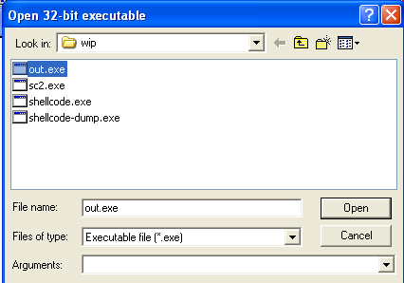
Opening an Executable
File > Open >
Arguments to run the PE

Slide 15
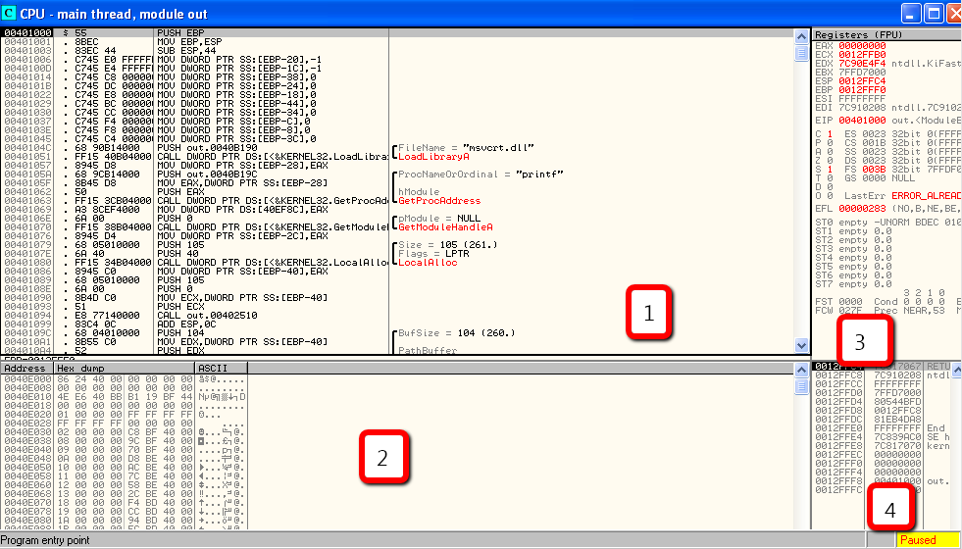
OllyDBG Windows
Disassembler
Register
Memory Dump
Stack

Slide 16
OllyDBG Windows
Disassembler Window
Displays the debugged program codes
The next instructions is highlighted in grey
Instruction can be modified by pressing spacebar
Register Window
Displays the current state of the registers
Registry changes are highlighted in red
You can make changes to the registry by right-clicking on it and choose ‘modify’

Slide 17
OllyDBG Windows
Stack Window
Shows the current state of the stack
Useful information when trying to understand a function
Memory Dump Window
A dump of live memory
Ctrl-G on this window to go to a specific memory address
Can edit live memory by right clicking, Binary > Edit

Slide 18
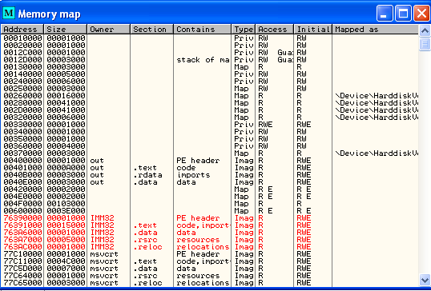
Memory Map
View > Memory >
Displays how the program is laid out in memory.

Slide 19
Rebasing
When PE runs, it may not run at the preferred base address.
The OS can choose to rebase the PE to a different address for performance or security reasons
The memory map allows you to see exactly how the PE occupy memory after rebasing.
Q: Does the PE memory layout in OllyDBG similar to that in IDA Pro?

Slide 20
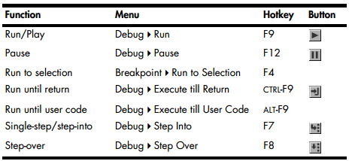
Executing the Code
Run until return, runs every instruction up until the function returns
Run until user code, runs until we reach user-code (completes execution of all codes within system dlls)

Slide 21
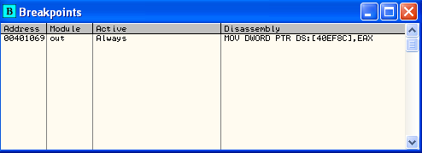
Breakpoints
Press F2 to set / unset a breakpoint
To show all breakpoints, click the icon

Slide 22
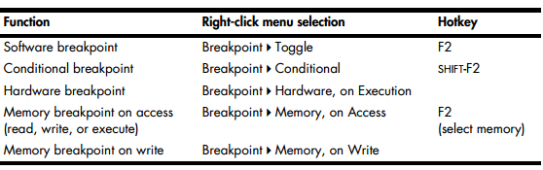
Breakpoints
Conditional Breakpoints are software breakpoints that will break only if certain conditions are true

Slide 23
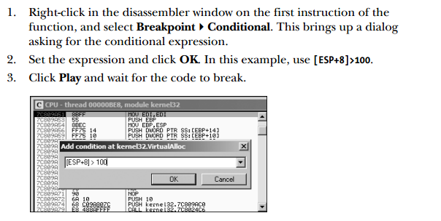
Conditional Breakpoints
Conditional Breakpoints are software breakpoints that will break only if certain conditions are true

Slide 24
Hardware Breakpoints
These breakpoints are very useful because they do not alter your code or stack
They don’t slow down execution
The issue is that you can only set four hardware breakpoints at one point in time
Breakpoint > Hardware, on Execution

Slide 25
Memory Breakpoints
Allows you to set breakpoints on a chunk of memory
As soon as the memory chunk is accessed, the breakpoint will trigger
You can only set one memory breakpoint at a time.
Breakpoint > Memory, on Access

Slide 26
Loading DLLs
OllyDBG can load & debug DLLs
It uses a dummy program loaddll.exe to load the dll
Useful when malware is packaged as a DLL
To call a specific DLL export function,
Debug > Call DLL Export

Slide 27
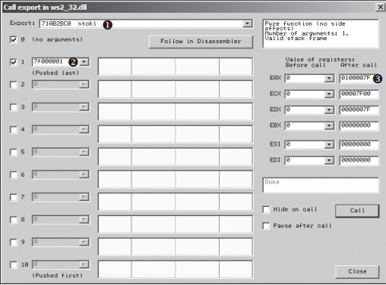
Calling a DLL Export
Debug > Call DLL Export

Slide 28
Exception Handling
When an exception occurs, program pause execution and control is given back to OllyDBG
OllyDBG can handle the exception or pass it back to the program to handle it.
Shift-F7: Steps into exception
Shift-F8: Steps over it
Shift-F9: Runs the exception handler

Slide 29
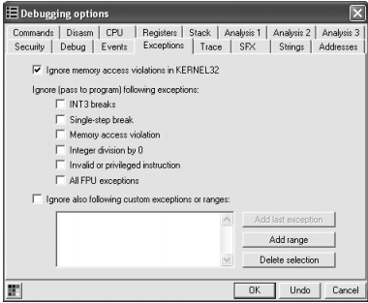
Exception Handling
OllyDBG can be configured to ignore some of the common exceptions

Slide 30
Patching
You can modify instructions or memory chunk live when the program is being debugged
Right-Click then choose, Binary > Edit

Slide 31
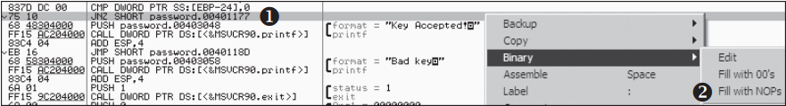
Patching - Example
At (1), we see that the program is checking whether the password is Accepted
We can fill this check with NOPs

Slide 32
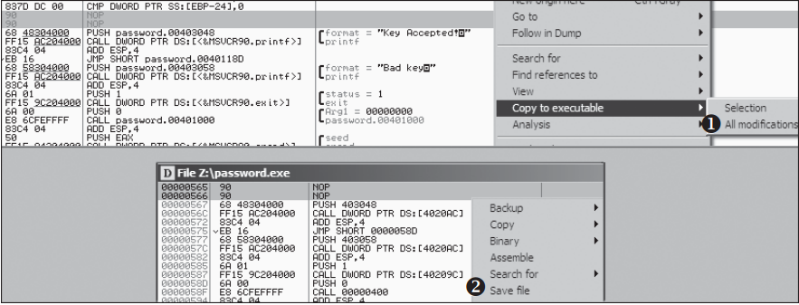
Patching - Example
The patch currently exists live in memory
We can make the patch persistent by copying back to the physical PE file

Slide 33
Summary
Debugging a PE using OllyDBG
Breakpoints
Memory Map
Loading DLLs
Exception Handling
Patching

Slide 34
Tutorial
https://www.youtube.com/watch?v=jIaImASmto4&list=PL5F0EC1C71D5CC9A7

